Slide 1
STOR 455 Class 8
Read: 2.1, 2.3, 2.4
Exercises: 2.15b, 17bcd, 19bc

Slide 2
Inference for Slope and Intercept
Find a confidence interval of plausible values for the parameter.
Test a hypothesis about a possible value for the parameter

Slide 3

Sampling Distribution
Population
BUT, in practice we don’t see the “tree” or all of the “seeds” – we only have ONE seed
$$β_{i}$$

Slide 4


Bootstrap Distribution
Estimate the distribution and variability (SE) of ${\hat{β}}_{i}$from the bootstraps
What can we do with just one seed?
Bootstrap
“Population”
Grow a NEW tree!
$${\hat{β}}_{i}$$
$$β_{i}$$

Slide 5
Simple Linear Regression
moddist=lm(Distance~Hours, data=Domestic)
summary(moddist)
Call:
lm(formula = Distance ~ Hours, data = Domestic)
Residuals:
Min 1Q Median 3Q Max
-88.892 -4.680 2.172 7.082 26.141
Coefficients:
Estimate Std. Error t value Pr(>|t|)
(Intercept) -11.063 4.056 -2.727 0.00868 **
Hours 59.977 2.484 24.144 < 2e-16 ***
---
Signif. codes: 0 ‘***’ 0.001 ‘**’ 0.01 ‘*’ 0.05 ‘.’ 0.1 ‘ ’ 1
Residual standard error: 18.26 on 52 degrees of freedom
Multiple R-squared: 0.9181, Adjusted R-squared: 0.9165
F-statistic: 582.9 on 1 and 52 DF, p-value: < 2.2e-16

Slide 6
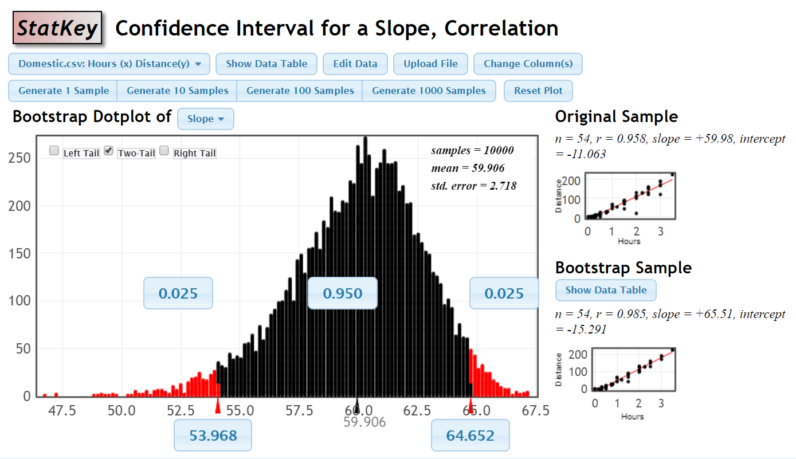
Bootstrap Distribution

Slide 7
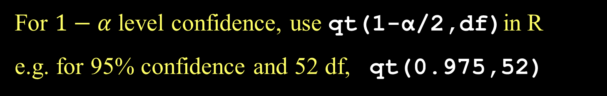
CI for Slope or Intercept
t* comes from a t-distribution with n-2 d.f and depends on the level of confidence
For $1−α$ level confidence, use qt(1-α/2,df)in R
e.g. for 95% confidence and 52 df, qt(0.975,52)

Slide 8
How to find a confidence interval?
confint(mymodel,level =0.XX) and adjust for the confidence level.
2.5 % 97.5 %
(Intercept) -19.20166 -2.92358
Hours 54.99264 64.96233

Slide 9
Accuracy of Predictions
Example:
It takes a student 2.25 hours to drive from home. How many miles do we predict that thy are away from home?
How accurate is that prediction?

Slide 10
Two Forms of Intervals for Regression
Confidence Interval for μ_{Y} (mean Y)
Where is the “true” line for that x? or
Where is the average Y for all with that x?
Prediction Interval for Individual Y
Where are most Y’s for that x?

Slide 11

CI for μ_{Y} when X=x*
SSX = $\sum{{(x_{i} − \overline{x})}^{2}}$

Slide 12

Prediction Interval for Individual Y’s when X=x*
accounts for ε in model
SSX = $\sum{{(x_{i} − \overline{x})}^{2}}$

Slide 13
CI and PI via R when X=x*
newx=data.frame(Hours=2.25)
View(newx)
predict.lm(moddist, newx, interval="confidence")
predict.lm(moddist, newx, interval="prediction")
fit lwr upr
1 123.8867 116.9764 130.797
fit lwr upr
1 123.8867 86.59458 161.1789

Slide 14
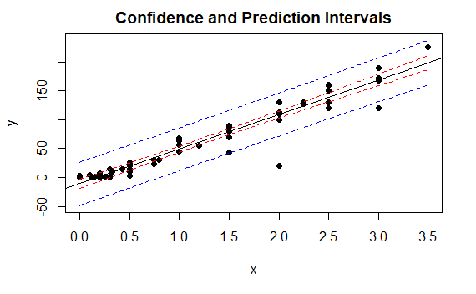
CIPIPlot(Domestic$Hours, Domestic$Distance)

